Slide 1
GeoX 2017
Lab Exercise

Slide 2
Start GeoX 2017
There is an shortcut on the desktop
Or search under programs for Schlumberger

Slide 3
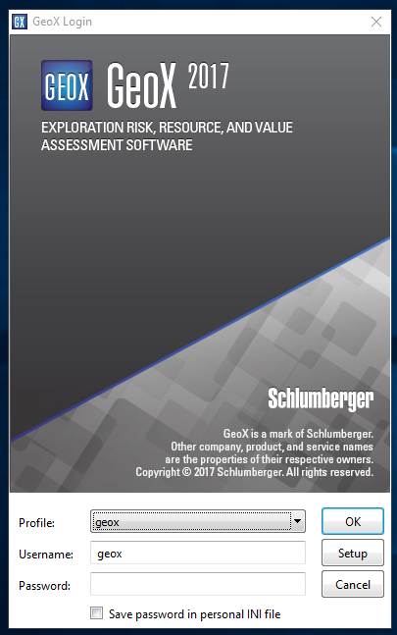
Password is geox

Slide 4
License Selection
Select Discovery Package

Slide 5
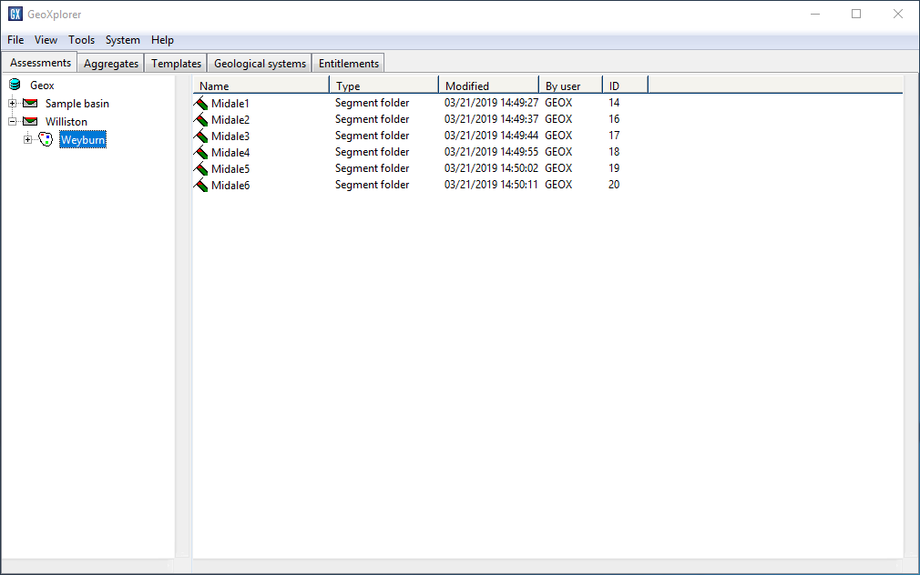
Open up Williston
Open up Weyburn
Select your team’s segment
Midale1 thru 5

Slide 6
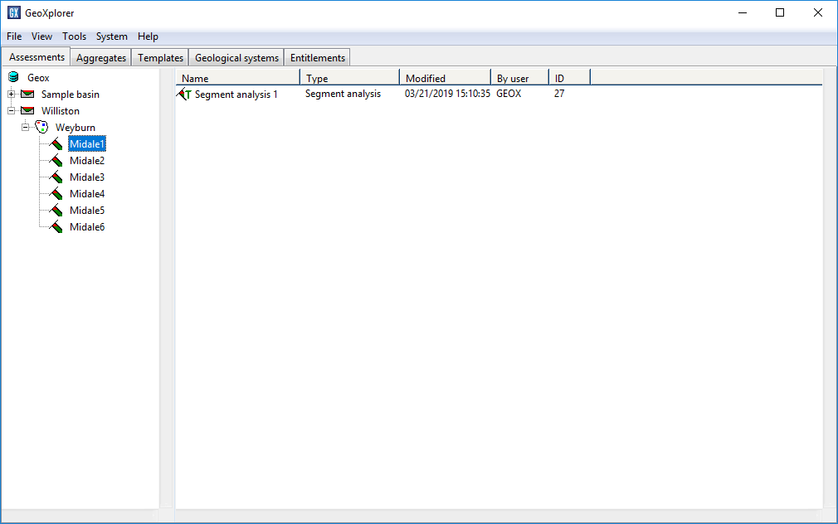
Right click on your team’s
segment analysis and
select open

Slide 7
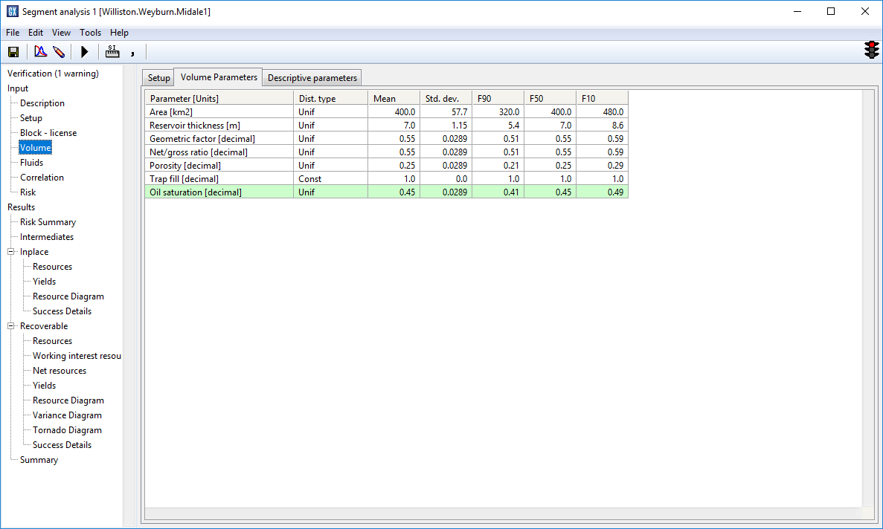
This is a Area, Thickness Oil Analysis
On the left panel select Volume
Change parameters as appropriate
Continue with fluids and risk

Slide 8
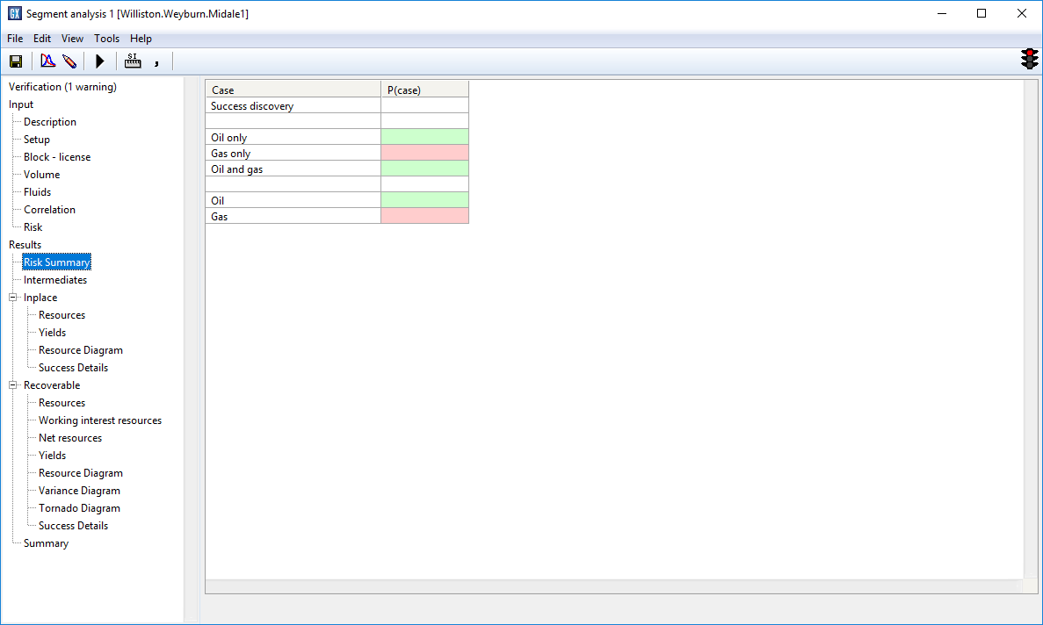
After all parameters are
Entered select the calculate
arrow on the button bar

Slide 9
Look at the
Tornado diagram

Slide 10
And look at the other
calculations

